Slide 1

HELPER Project Proposal Presentation
(Wednesday 1 July 2015)

Slide 2
P R O P O S A L S C H E D U L E
A written offer from a developer team
A essential step in the compound process
First act before begin implementation

Slide 3
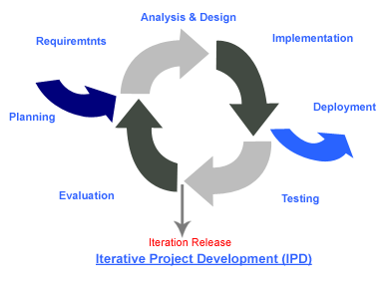
Iterative Model
Advantages
Define the design solution for the entire product.
Building and improving the product step by step. Hence we can track the defects at early stages.
Get the reliable user feedback. When presenting sketches and blueprints of the product to users, we are effectively asking them to imagine how the product will work.
Less time is spent on documenting and more time is given for designing.

Slide 4
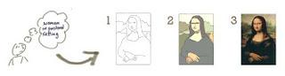
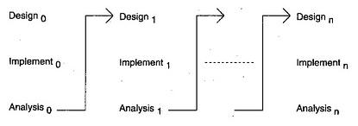
When to use Iterative Model ?
Requirements of the complete system are clearly defined and understood
Major requirements must be defined; some details can evolve with time
 http://istqbexamcertification.com/what-is-iterative-model-advantages-disadvantages-and-when-to-use-it

Slide 5
ERP
Enterprise Resource Planing
Cons
Users have to adapt the routine work according to the workflows and ability of the program.
Some of features may not meet the requirement.
The program cannot modify anymore.
http://wit279.wordpress.com/assignment-erp/

Slide 6
HTML 5 > HTML 4
New medias manager APIs: form constraint validation, enables offline web applications, expose the session history
2. New technology replace traditional (Flash and javaFx)
3. Additional various elements (section, article, main, aside, footer, header, nav, template)
4. New attributes (type, target, charset, autofocus, placeholder, form, required)
http://www.w3.org/TR/html5-diff/

Slide 7
CSS 3 > CSS 2
(Module) (Model)
1. Separate selectors into a single module
2. Declare to Proposed Recommendation state
3. Important css3 modules (selectors, box model, backgrounds & borders, image values & replaced content)
http://www.w3schools.com/css/css3_intro.asp

Slide 8
http://www.softmelt.com/article.php?id=64
More interesting
HTML 5 + CSS 3
User Agents

Slide 9
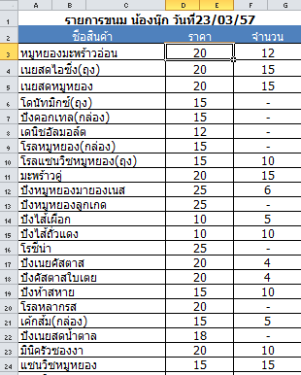
Phungnoi Business
Ordering stage

Slide 10


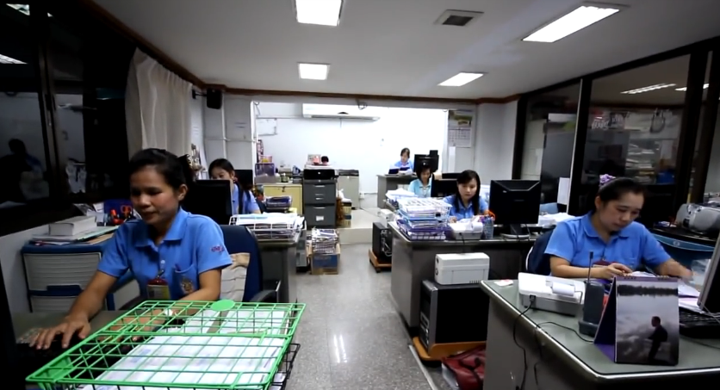
Phungnoi Business
Receiving stage

Slide 11
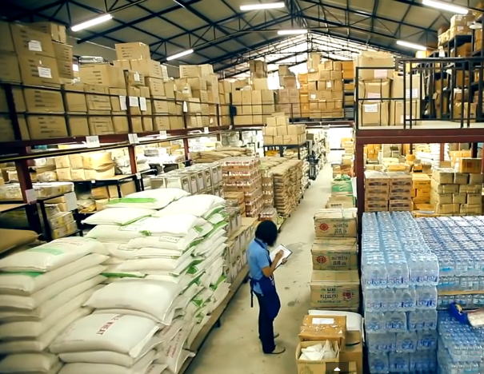
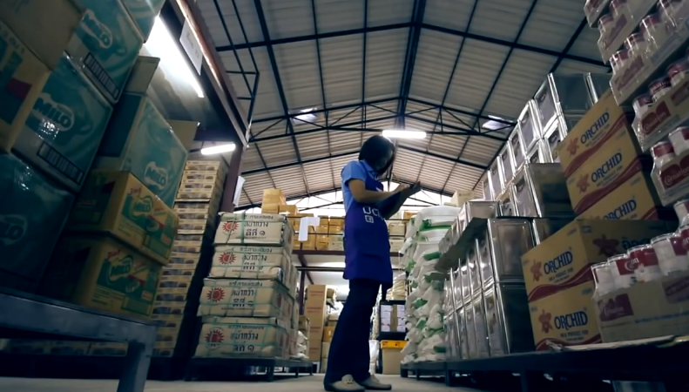
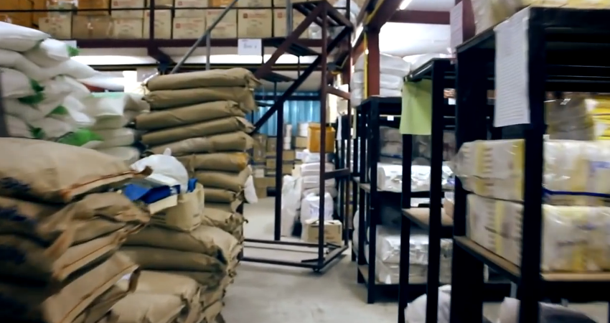
Phungnoi Business
Withdrawing stage

Slide 12

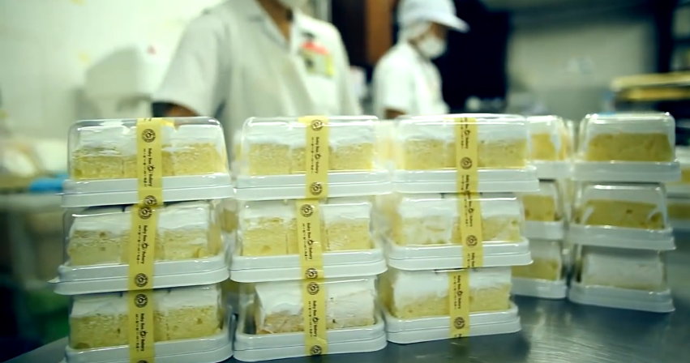
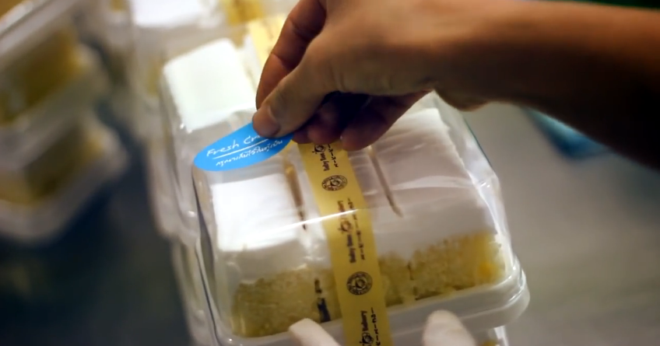
Phungnoi Business
Manufacturing stage

Slide 13

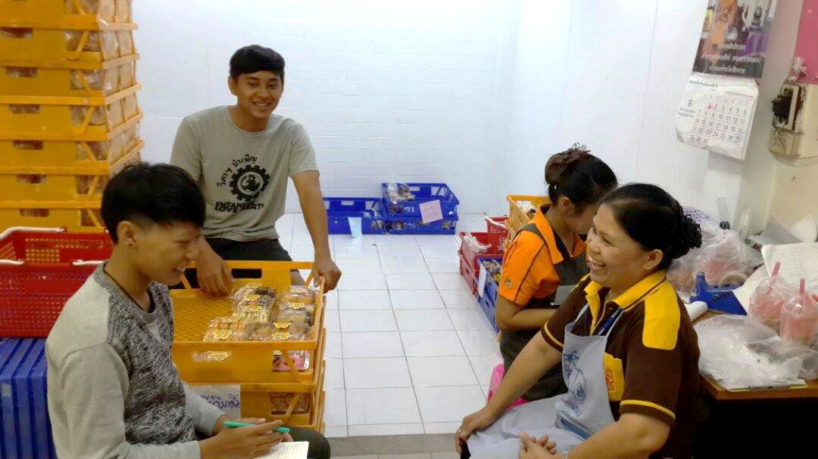
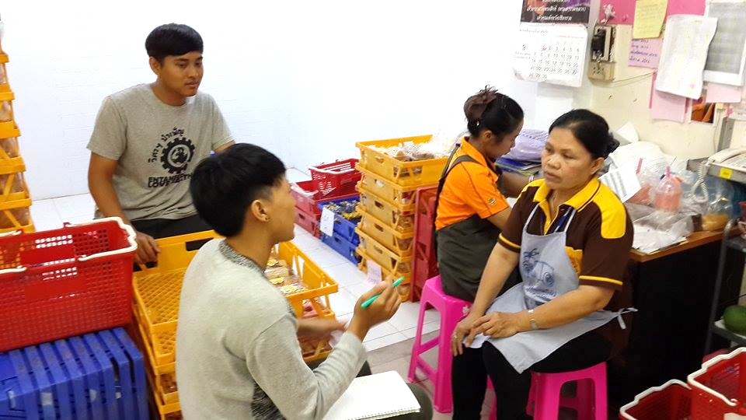
Phungnoi Business
Preparing stage

Slide 14


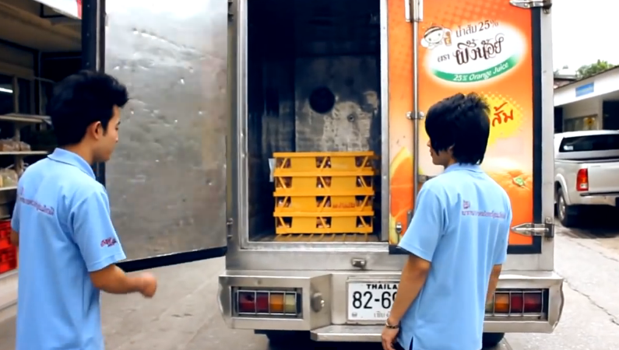
Phungnoi Business
Delivering stage

Slide 15
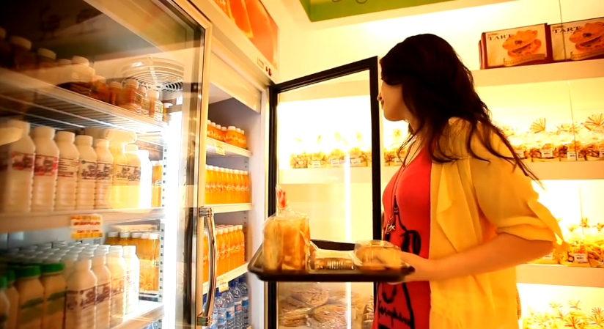


Phungnoi Business
Distributing stage
37 wholesalers
https://www.youtube.com/watch?v=JeKQbkrMSlQ

Slide 16
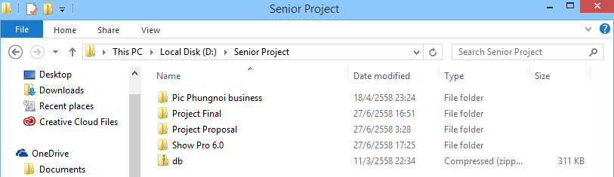
C
onfiguration Item Table

